Slide 1


Slide 2
Agenda
Financial Planning
Insurance and Legal Documents
Saving and Investing
Managing Debt and Credit
Resources

Slide 3
Financial Planning

Slide 4
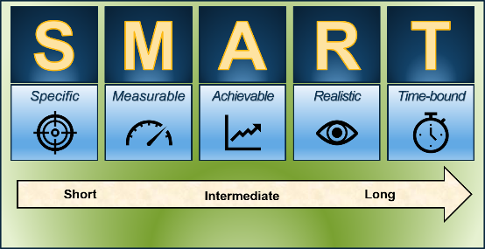
Setting Financial Goals
Write down your financial goals
Prioritize your goals and determine how much you need to save each month to achieve them
If necessary, turn them into SMART goals

Slide 5
SMART Activity
SGT Sanders will save $334 per month for nine months to put a $3,000 down payment on a vehicle.
S – What is he trying to accomplish?
M – How much will he save for a specific time frame?
A – Is the goal achievable or wishful thinking?
R – Is the goal relevant and important to stay on track?
T – Is there a target date for the accomplishment?

Slide 6


Spending Plan
Create and update your spending plan
Set up automatic bill pay
Account for changes to income, taxes, and expenses
Increased Income
Combat Zone Tax Exclusion (CZTE) Hostile Fire/Imminent Danger Pay (HFP/IDP) Family Separation Allowance (FSA)
Reduced Expenses
Living expenses Income tax Lower debt payments

Slide 7
Special Pay and Entitlements
Special Pays
Hostile Fire Pay/Imminent Pay (HFP/IDP)
Family Separation Allowance (FSA)
Hardship Duty Pay (HDP)
Per Diem

Slide 8
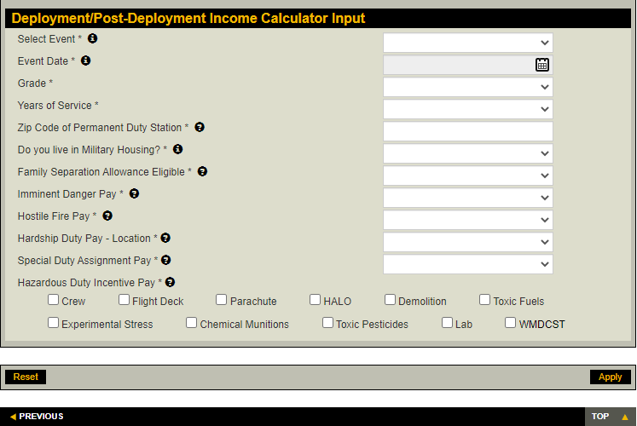
Deployment Income Calculator
Source: https://myarmybenefits.us.army.mil/custom/deployment/input

Slide 9

Taxes
Combat Zone Tax Exclusion (CZTE)
  Exempts all or a portion of earnings from federal income taxes while deployed to a designated combat zone
  Unlimited for enlisted Soldiers
  Officer’s pay is limited to the maximum rate for enlisted Service members plus hostile fire or imminent danger pay.
Tax filing considerations and residency
Resources

Slide 10
Insurance and Legal Documents

Slide 11
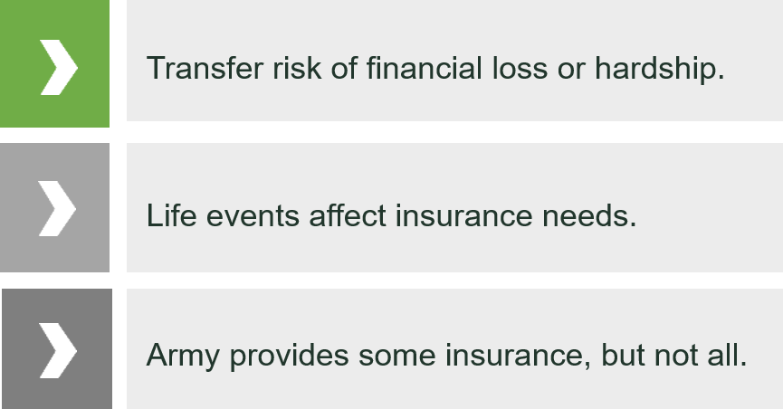
The Purpose of Life Insurance

Slide 12
Insurance Overview
Coverage Options
  SGLI
  Beneficiaries
  Private policy (Term/Permanent)
  War clause and other restrictions
TRICARE
Auto, Homeowners, Renters, Dental
  Review and update your current insurance policies

Slide 13
Life Insurance Needs
Liabilities (debts and obligations)
Income (amount X number of years needed)
Final expenses
Education and other goals
+
+
+
-
Subtract current coverage and assets
Your Total Need

Slide 14
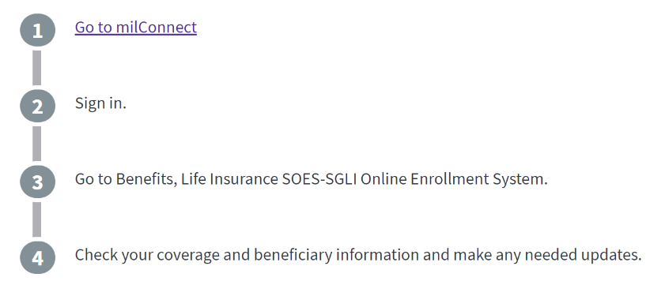

How to Change Your SGLI
SGLI Online Enrollment System (SOES):
Replaces paper-based SGLI enrollment, maintains elections and beneficiary information
Provides 24/7 self-service SGLI information
www.dmdc.osd.mil/milconnect

Slide 15
Legal Documents
Review and update important documents such as:
  Will
  Power of Attorney
  Living Will
  Medical directives
  DD Form 93
  Form TSP-3
  Religious preference
  Home of record considerations
Safeguard information and documents while deployed

Slide 16
Survivor Benefits (while on active duty)
Servicemembers’ Group Life Insurance (SGLI)
Casualty Assistance Office
Dependency and Indemnification Compensation (DIC)
The Heroes Earning Assistance and Relief Tax (HEART) Act
VA Burial at any National Cemetery
Survivor Benefit Plan (SBP)
Survivor Outreach Services (SOS)
Death Gratuity - $100,000
Social Security Survivors Benefits

Slide 17
Update Beneficiaries
Be sure to review and update the following as needed:
  DD93
  SGLI
  TSP-3
  Will
  Private policies
  Bank accounts
  Other retirement or investment accounts
Legal Ramifications

Slide 18

Survivors’ Education Benefits
 | Survivors’ and Dependents’ Educational Assistance (DEA) Program | Fry Scholarships
Eligibility | Child or Spouse of a Soldier who: Is permanently and totally disabled Died while on active duty Is missing in action Was forcibly detained Is being treated for a service-connected disability | Child or surviving spouse of an active duty Soldier who died in the line of duty on or after September 11, 2001
Benefits | Monthly payments to help cover the cost of: College or graduate degree programs Career-training certificate courses Educational and career counseling Apprenticeships On-the-job training | You may be able to get up to 36 months of benefits, including: Money for tuition Money for housing Money for books and supplies

Slide 19
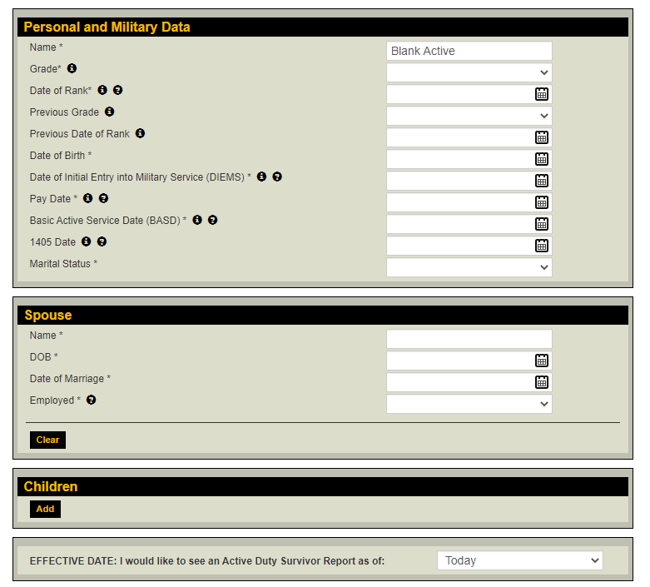
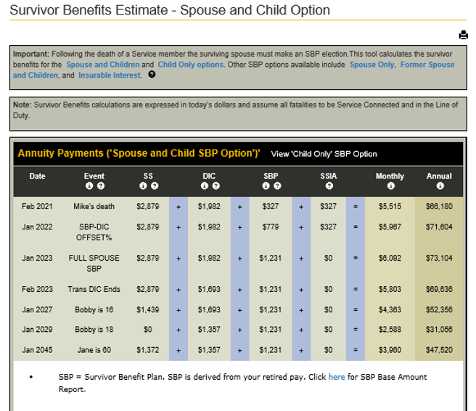
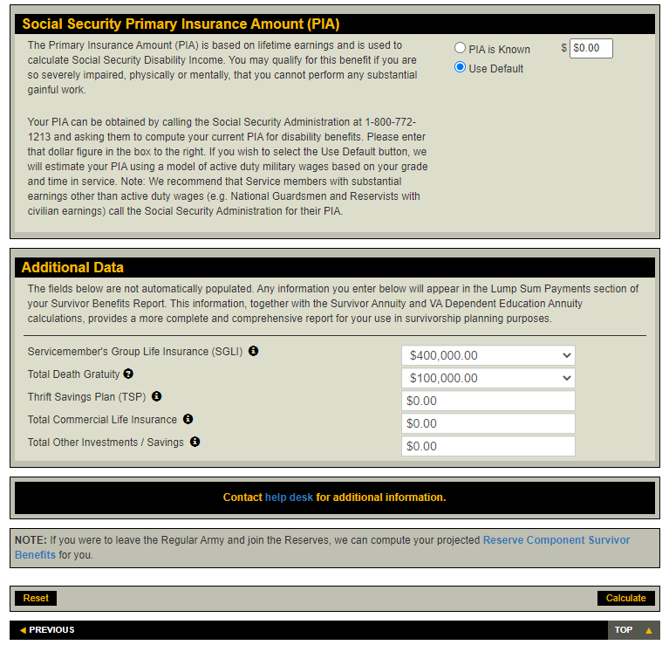
Survivor Benefits Calculator
Source: https://myarmybenefits.us.army.mil/Benefit-Calculators/Survivor-Benefits

Slide 20
Saving and Investing

Slide 21

Emergency Funds
Strive to save and maintain 3 - 6 months of living expenses
Automate savings
Keep funds accessible

Slide 22
Savings Deposit Program (SDP)
Deployed to designated combat zone
Deposit up to $10,000
Earn 10% taxable interest, compounded quarterly
Withdrawals
  Emergency
  Automatic direct deposit after 120 days
  Visit https://www.dfas.mil/
22

Slide 23
Calculate Your Earnings
Savings Deposit Program
  Estimate your earnings
    Multiply the average quarterly balance by 0.025 (10% ÷ 4)
  Example
    SGT Jones has an average quarterly balance of $3,000
    $3,000 x .025 = $75
    She earned $75 that quarter

Slide 24
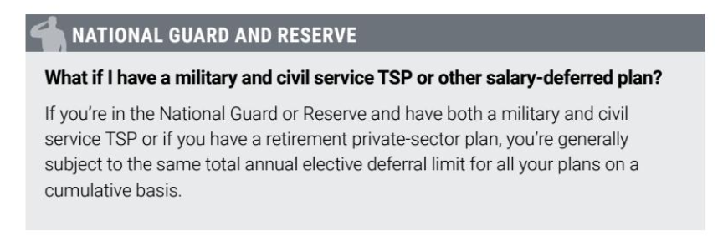
Thrift Savings Plan (TSP)
Combat Zone Tax Exclusion
  Allows for additional contributions into the TSP

Slide 25
Managing Debt and Credit

Slide 26

Financial Warning Signs
Living paycheck to paycheck
Unable to pay bills
Bounced checks
Expensive purchases
Spouse lost job
Divorce/separation
No savings
Preoccupied and distant

Slide 27
Mission Readiness
Military Values
  Duty to warn
Consequences of financial problems
  Non-Judicial Punishment
  Administrative discharge
  Revocation of security clearance
  Loss of promotion or duty assignment
Leader’s responsibility
  Confidentiality
  Be direct, but understanding
  Refer for assistance

Slide 28
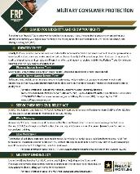
Military Consumer Protections
Notify lenders about deployment
Active-duty alert and security freeze
Review credit report
  Speak to a Personal Financial Manager/Counselor on your installation for credit questions
  Visit www.annualcreditreport.com
  Soldiers may request FREE credit monitoring from each of the reporting agencies
Know your rights
  Servicemembers Civil Relief Act (SCRA)
  Military Lending Act (MLA)
  Legal Office

Slide 29
Servicemembers Civil Relief Act (SCRA)
Benefits and Protections
Prevents eviction and the repossession of property | 6% cap on debt incurred prior to entering active duty
Postpones foreclosure | Terminates cell and residential phone service
Postpones vehicle foreclosure | Terminates vehicle lease
Protections against default judgments | Terminates housing lease if entering military service, PCS, or deployment for 90 days or more
Prevents selling of belongings in self-storage facility for overdue rent without court order | State tax relief
Postpones civil court matters | Protects against existing life insurance coverage
Protects small-business owners regarding company debts or obligation | Protects credit rating

Slide 30
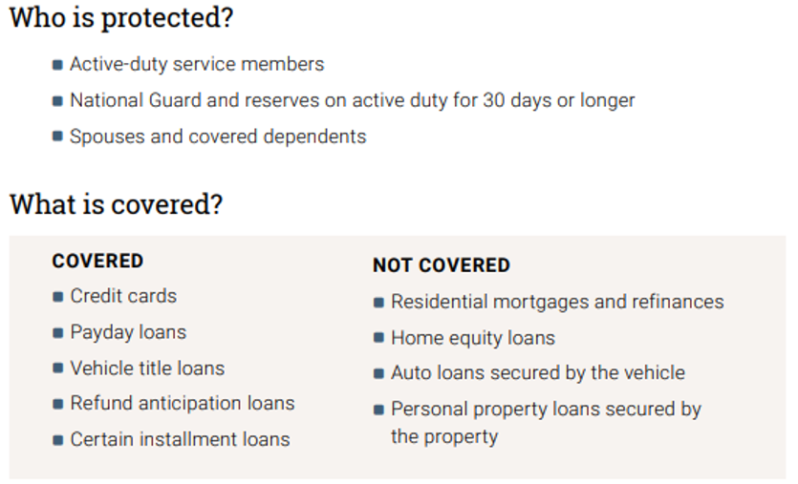
Military Lending Act

Slide 31

Identity Theft
Secure your information
  Follow Personally Identifiable Information regulations and procedures
  Opt out and do not call
While deployed
  Active-duty alert or credit freeze
Additional information
  Visit www.identitytheft.gov
  Visit www.consumer.gov

Slide 32

Misleading Consumer Practices
Recognize scams
  Multilevel marketing/pyramid scheme
  Get rich quick
  Too good to be true
Protect yourself
  Research
  Comparison shop
  Sleep on it
Report a complaint

Slide 33
Summary and Resources
33

Slide 34
Summary
Best wishes for a safe and financially successful deployment!
Let’s wrap up all the topics we talked about today:
  Financial Planning
  Insurance and Legal Documents
  Saving and Investing
  Managing Debt and Credit
  Resources

Slide 35
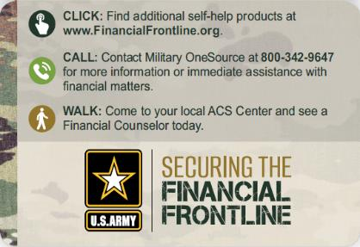
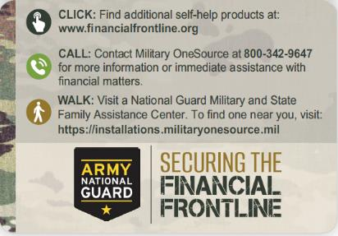
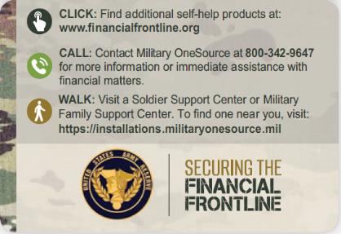
Resources and Conclusion

Slide 36
Thank You!

